Slide 1
Name:-Siba prasad sahu

Slide 2
Task 3: Responsive Design
Objective: Ensure the webpage layout adjusts appropriately for different screen sizes, improving user experience across various devices.
Steps:
1.Use media queries in a separate CSS file (styles.css) to make the webpage responsive.
2.Adjust layout and element sizes for different screen sizes, ensuring readability and usability.
3.Test responsiveness by resizing the browser window or using developer tools.

Slide 3
Index.html:-
<!DOCTYPE html>
<html lang="en">
<head>
<meta charset="UTF-8">
<meta name="viewport" content="width=device-width, initial-scale=1.0">
<title>Task 3 - Responsive Design</title>
<link rel="stylesheet" href="styles.css">
</head>
<body>
<header>
<h1>Responsive Webpage</h1>
</header>
<main>
<section>
<h2>About Responsive Design</h2>

Slide 4
<p>
Responsive design ensures that a webpage looks good on all devices—
desktops, tablets, and smartphones—by adjusting layout and element sizes
automatically.
</p>
<img src="https://via.placeholder.com/400" alt="Sample Image">
</section>
</main>
<footer>
<p>&copy; 2025 My Website</p>
</footer>
</body>
</html>

Slide 5

Sample image.jpg

Slide 6
Style.css:-
/* Base styles (default for large screens / desktop) */
body {
font-family: Arial, sans-serif;
margin: 0;
padding: 0;
line-height: 1.6;
background: #f9f9f9;
}
header, footer {
background: #007BFF;
color: white;
text-align: center;
padding: 15px;

Slide 7
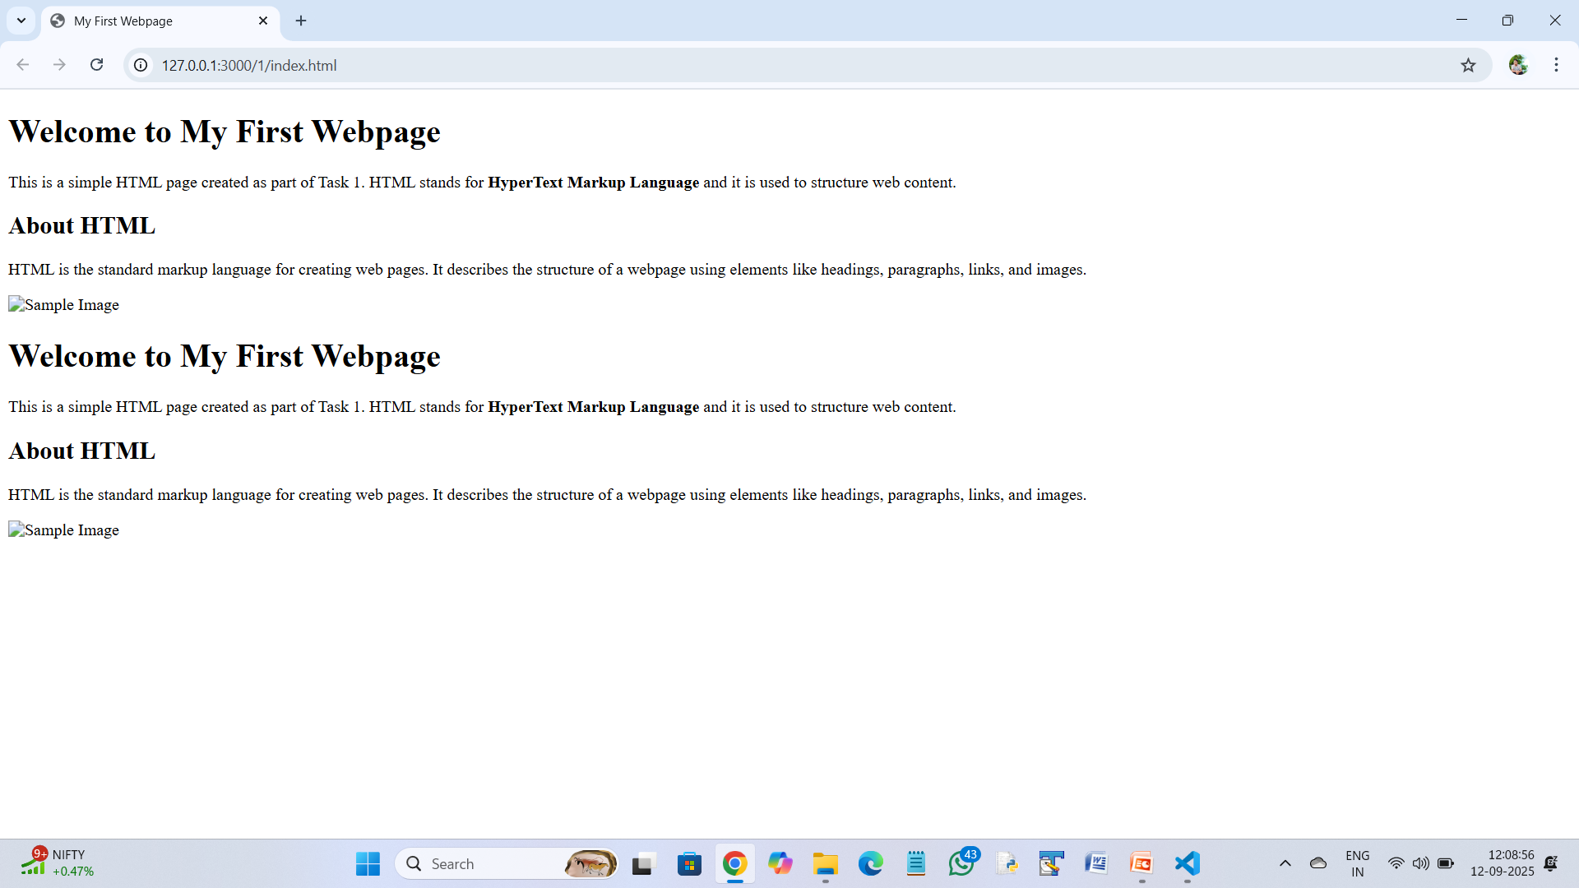
output

Slide 8
}
main {
padding: 20px;
max-width: 900px;
margin: auto;
}
img {
width: 100%;
max-width: 400px;
display: block;
margin: 20px auto;
border-radius: 10px;
}
/* Tablet view (screen width ≤ 768px) */
@media (max-width: 768px) {
body {
background: #eef7ff;

Slide 9
}
h1 {
font-size: 28px;
}
p {
font-size: 16px;
}
img {
max-width: 300px;
}
}
/* Mobile view (screen width ≤ 480px) */
@media (max-width: 480px) {
header, footer {
padding: 10px;

Slide 10
}
h1 {
font-size: 22px;
}
h2 {
font-size: 18px;
}
p {
font-size: 14px;
}
img {
max-width: 200px;
}
}

